Slide 1
IOT BRIDGE HEALTH MONITORING SYSTEM
BSC-29-18 (ANDRINAH KAUNDA)
BSC-COM-NE-10-18(PATRICK MABZINESS)
BSC-04-16(TINASHE DZAUYA)
BSC-COM-NE-06-17(TERESA MFUSE)

Slide 2
Problem Statement
There have been cases in Malawi where bridges have collapsed unexpectedly, due to the fact that there is no system available to monitor the health status of the bridges.
Currently there is no adequate method for ensuring whether the bridge is safe for traveling or not, there are only assumptions that the bridges are safe .
Due to this, when affected by natural disasters or other factors that may cause bridges to collapse, all the hard work of various labours and the money invested for the construction of the bridge may go to vain
The most important thing is to reduce the accidents which may occur on the bridge that may put people’s lives in jeopardy.
Notes:
For example, this year we have experienced cases like: the M2 Peter Muthalika road bridge which was damaged due to incessant(continuos) rains,
Lisungwi bridge damaged due to vibrations caused by cyclones and also two people were washed away together with the bridge in Machinjiri due to raging rains.

Slide 3
Objectives
The aim of this project is to design and develop an IOT based Bridge health monitoring System to ensure the structural integrity and safety of the bridges
The system should be capable of monitoring various parameters such as vibrations, deformation and environmental factors such as rain.
The system should provide real time data analysis which can help predict failures and schedule maintenance ,and also alert relevant authorities or personnel in case of any safety hazards or abnormality.
Notes:
AMONG OTHERS: Monitor fatigue and collision of materials

Slide 4
Target users
Malawi Roads Authority
All road users.

Slide 5
Comparison
Existing System
Proposed System
Not aware of the safety of the structure.
Lack of sensor technology
Lack of real time monitoring system.
Unnecessary occurrences of accidents.
All labour works ending in vain.
Being aware of bridge conditions which can help minimize accidents
A real time monitoring system
Uses different types of sensor technology
Can also, reduce accidents related to weather conditions

Slide 6
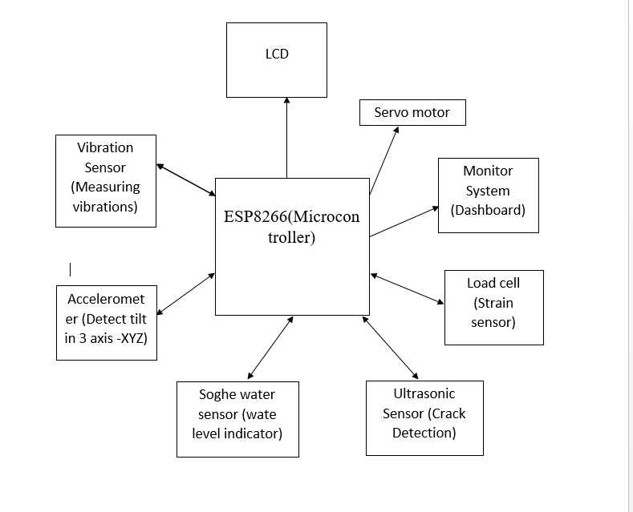
Design(Block diagram)
Notes:
For us to achieve our objective, we have microcontroller ESP8266 for the programming logic.
#add sensor data
When we gather data from the sensors, our microcontroller will send data to be displayed on lcd and dashboard. It will also send instructions to the servo motor to close or open the road

Slide 7
Functional Requirements
Alerting and notifying .
Real time data collection.
Remote monitoring.

Slide 8
Tools
HARDWARE REQUIREMENTS
Sensors : Vibration, Load cell, songhe Water level, ultrasonic , accelerometer.
Display : LCD.
Microcontroller : ESP8266
Others: Servo motor

